Slide 1
Addressing Modes of 8085
6
The microprocessor has different ways of specifying the data or operand for the instruction.
The various formats of specifying operands are called
addressing modes
The 8085 has Five addressing modes:
1) Register Addressing mode: This type of addressing mode specifies register or register pair that contains data.
Example: ADD B, MOV B,A

Slide 2
Addressing Modes of 8085
7
2) Immediate Addressing Mode:
In this type of addressing mode, immediate data byte is provided with the instruction.
Example: MVI A,47H
LXI H, 4100H etc.

Slide 3
Memory Addressing
8
One of the operands is a memory location
Depending on how address of memory location is specified, memory addressing is of two types
Direct addressing
Indirect addressing
3) Direct Addressing Mode: In this type of addressing mode, the 16bit memory address is directly provided with the instruction.
Example: LDA C500H
STA 3050H etc

Slide 4
Addressing Modes of 8085
9
4) Indirect Addressing Mode: In this type of addressing mode, the 16bit memory address is indirectly provided with the instruction using a register pair
Example: LDAX B
(Load the accumulator with the contents of the memory location whose address is stored in the register pair BC)
MOV M, A ;copy register A to memory location whose address is stored in register pair HL
H L
A
30H
20H
50H
2050H
30H

Slide 5
Addressing Modes of 8085
10
5) Implied or implicit Addressing mode: In this type of addressing mode, No operand (register or data) is specified in the instruction.
The operand is inborn to the instruction.
Example: CMA (Complement Accumulator) , RAL (rotated accumulator left), etc

Slide 6
Instruction Format
JIIT-128, Noida

Slide 7
Instruction Format
87
An instruction is a command to the microprocessor to perform a given task on a specified data.
Each instruction has two parts: one is task to be performed, called the operation code (opcode), and the second is the data to be operated on, called the operand.
The operand (or data) can be specified in various ways.
It may include 8-bit (or 16-bit ) data, an internal register, a memory location, or 8-bit (or 16-bit) address.
In some instructions, the operand is implicit.
JIIT-128, Noida

Slide 8
Instruction word size
87
The 8085 instruction set is classified into the following three groups according to word size:
1. One-word or 1-byte instructions
2. Two-word or 2-byte instructions
3. Three-word or 3-byte instructions
In the 8085, "byte" and "word" are synonymous because it is an 8-bit microprocessor.
However, instructions are commonly referred to in terms of bytes rather than words.
JIIT-128, Noida

Slide 9
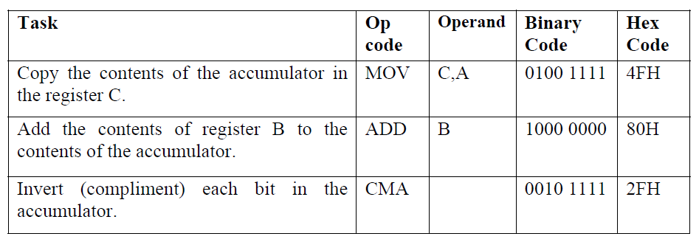
One-Byte Instructions
87
A 1-byte instruction includes the opcode and operand in the same byte.
Operand(s) are internal register and are coded into the instruction.
JIIT-128, Noida

Slide 10
One-Byte Instructions
87
In the first instruction, both operand registers are specified.
In the second instruction, the operand B is specified and the accumulator is assumed.
the third instruction, the accumulator is assumed to be the implicit operand
These instructions are stored in 8-bit binary format in memory; each requires one memory location.
JIIT-128, Noida

Slide 11
One-Byte Instructions Example
87
MOV rd, rs
rd <-- rs copies contents of rs into rd.
Example: MOV A,B
Coded as 01111000 = 78H
ADD r
A <-- A + r
JIIT-128, Noida

Slide 12
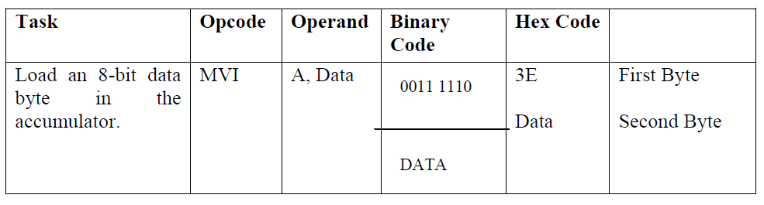
Two-Byte Instructions
87
In a two-byte instruction, the first byte specifies the operation code and the second byte specifies the operand.
Source operand is a data byte immediately following the opcode
JIIT-128, Noida

Slide 13
Two-Byte Instructions
87
Assume that the data byte is 32H. The assembly language instruction is written as
Mnemonics | Hex code
MVI A, 32H | 3E 32H
The instruction would require two memory locations to store in memory.
MVI r,data
r <-- data
Example: MVI A,30H coded as 3EH 30H as two contiguous bytes. This is an
example of immediate addressing.
ADI data
A <-- A + data
JIIT-128, Noida

Slide 14
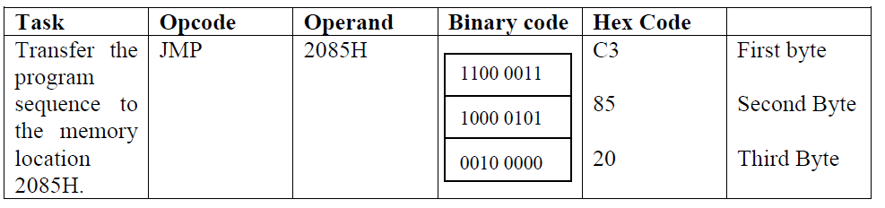
Three-Byte Instructions
87
In a three-byte instruction, the first byte specifies the opcode, and the following two bytes specify the 16-bit address.
The second byte is the low-order address and the third byte is the high-order address.
opcode + data byte + data byte
JIIT-128, Noida

Slide 15
Three-Byte Instructions
87
This instruction would require three memory locations to store in memory.
Three byte instructions - opcode + data byte + data byte
LXI rp, data16
rp is one of the pairs of registers BC, DE, HL used as 16-bit registers.
The two data bytes are 16-bit data in L H order of significance.
rp <-- data16
JIIT-128, Noida

Slide 16
Three-Byte Instructions
87
Example:
LXI H,0520H coded as 21H 20H 50H in three bytes. This is also immediate
addressing.
LDA addr
A <-- (addr) Addr is a 16-bit address in L H order. Example: LDA 2134H coded as
3AH 34H 21H. This is also an example of direct addressing.
JIIT-128, Noida

Slide 17
References
1. Gaonkar, R. S. (1990). Microprocessor Architecture, Programming and Applications with the 8085. Fifth Edition Prentice Hall PTR.

